Slide 1


The Impact of Behavioral Traits of Gen X and Millennials on Obesity.
Dan K, Darlene B, Darlene K,
Taylor R.

Slide 2

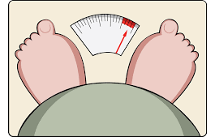
Introduction
Health condition: Classification of obesity in Gen M (ages 18-34) and Gen X (35-54)
Behaviors: Consumption of nutrients (fruits and vegetables) and physical activity
Range/Duration: 8-year period from 2011-2018
Notes:
Speaker Notes: Group 2 explored lifestyle behaviors between populations of Gen M and Gen X. This study examines these behaviors over a five-year period showing trends between and diet and exercise. The data was collected via in person health interviews. For the purpose of this study, nutritional habits are defined as the percent of adults reported consuming fruits and vegetables less than one time a day. Exercise is defined as the percentage of adults who engaged in NO leisure-time physical activity.

Slide 3

Hypothesis
Is there a relationship between physical activity/eating behaviors and obesity?
H0 – There is no relationship.
H1 – There is a relationship
Notes:
Speaker Notes: The origin of this study started with the access and impact of nutrition to several conditions including death. The group focused on the condition of obesity and to land on the parameters we set for this study asked a variety of questions. Recognizing varying factors to obesity we focused on the consumption of healthy foods and exercise as according to the CDC poor nutrition contributes to obesity and active people are at less risk for serious health problems like obesity.
Describe whether you were able to answer these questions to your satisfaction, and briefly summarize your findings.
In most cases we were able to answer these questions however, in one particular instance, there wasn’t a one to one comparison to make the correct assumption. For instance, we weren’t able to show the correlation between exercise and nutrition because there were 4 questions with different parameters for physical exercise and 1 question with the same parameter for nutrition.

Slide 4

Questions & Data Explored
Questions Asked…
Origin: Access to healthy nutrition and the relationship to heart disease, obesity and mortality rates.
Is there a significant difference between generations as it relates to obesity and physical activity?
Is there a significant difference between generations as it relates healthy eating and obesity?
Is there a correlation to the amount of exercise and nutrition to being obese?
Our analysis will examine the relationship between nutritional and lifestyle behaviors (diet, exercise, etc..) and the rates of obesity between Millennials and Gen X.

Slide 5



What kinds of data was needed? Where did we find it
BRFSS - The Behavioral Risk Factor Surveillance System is the nation’s premier system of health-related telephone surveys that collect state data about U.S. residents regarding their health-related risk behaviors, chronic health conditions, and use of preventive services.
NHANES - The National Health and Nutrition Examination Survey is a program of studies designed to assess the health and nutritional status of adults and children in the United States. The survey is unique in that it combines interviews and physical examinations.

Slide 6
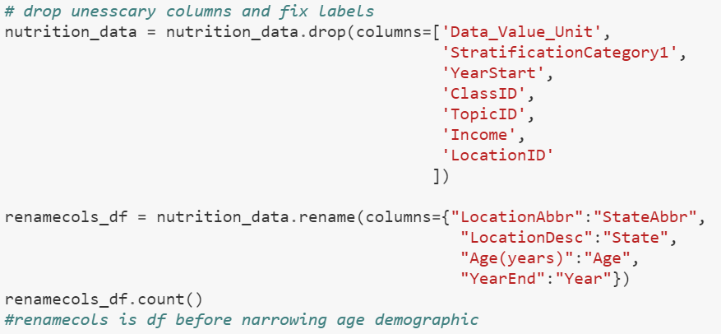
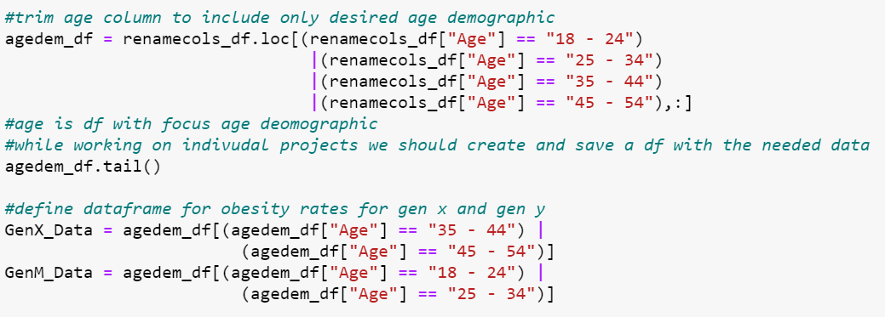
Data Cleanup & Exploration
Dealing with too much data
Separating GeoLocation data into Lat and Long columns
Narrowing the data down to our focus age demographic
Cleaning column labels for cleaner code. (i.e. LocationDesc -> State, and Age(years) -> Age)

Slide 7
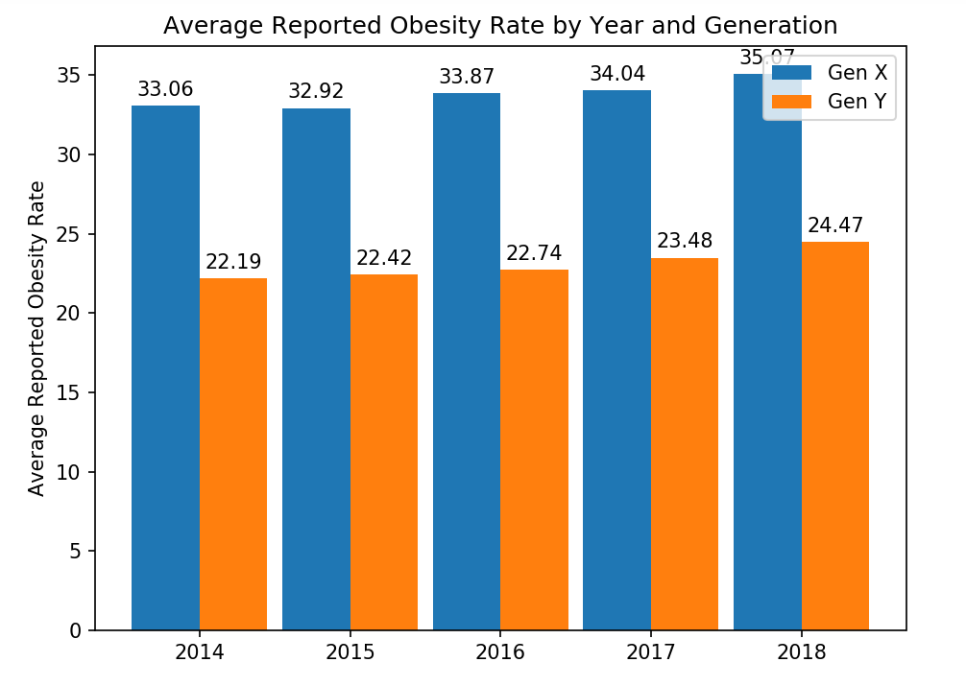
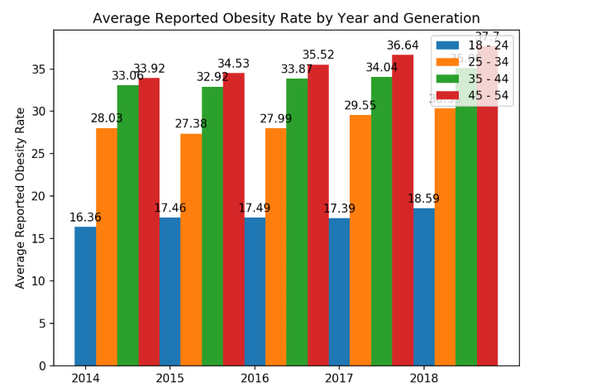
How have obesity rates of Gen X and Gen Y changed over the years?
Self Reported Rates of Obesity
Further Exploration of Rates

Slide 8
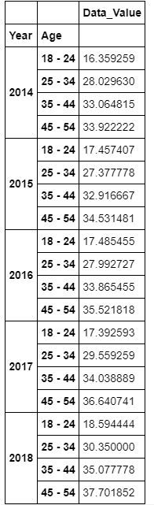
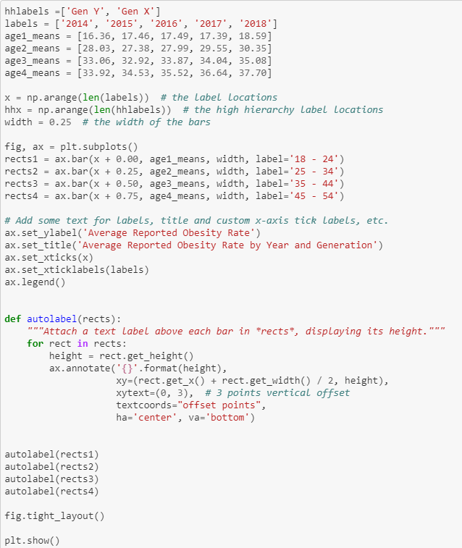
Behind the scenes of obesity rates bar graph
The concept is simple create a bar graph with multiple series.
Create lists including the means (made formatting very simple)
Used table to find and sort the means by year and age/gen
subject = ['Data_Value']
dataset = obesity_data_df.groupby(['Year','Gen'])[subject].mean()
dataset

Slide 9
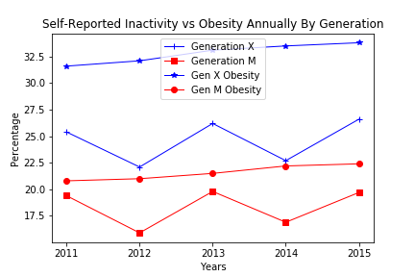
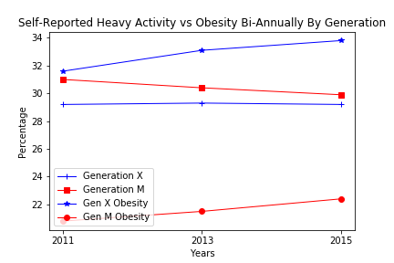
Does activity affect obesity over time, and how does it relate to different generations?
Percent of adults who achieve at least 300 minutes a week of moderate intensity aerobic physical activity or 150 minutes a week of vigorous intensity aerobic activity
Percent of adults who engage in no leisure-time physical activity

Slide 10
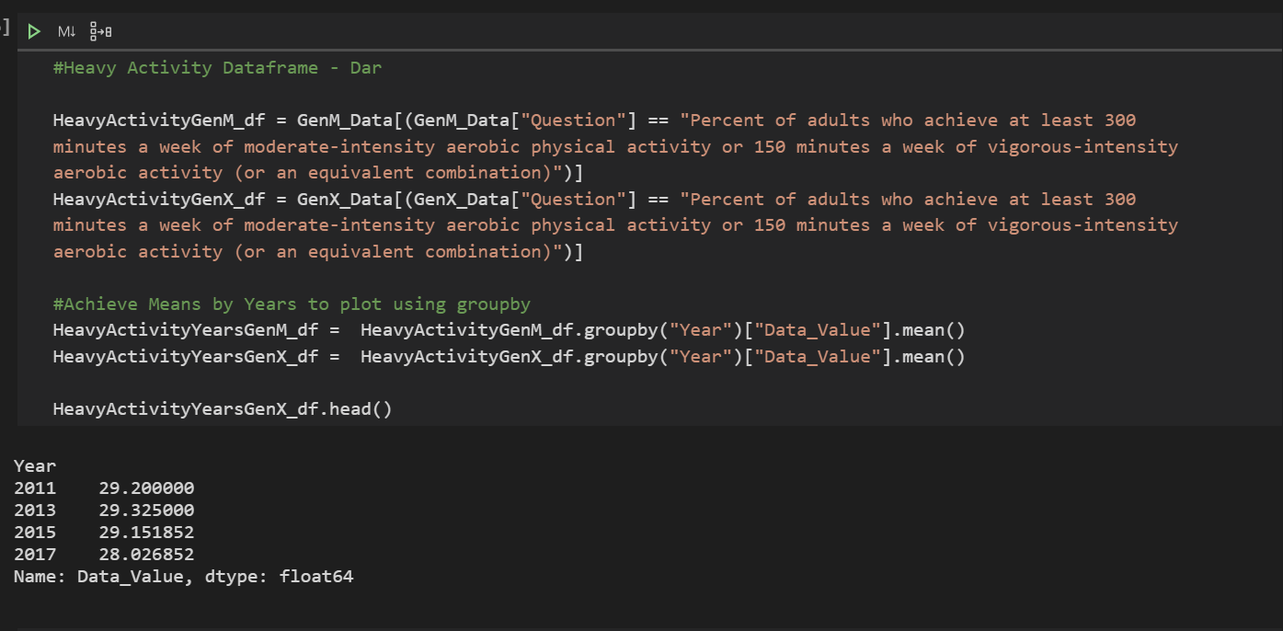
Does activity affect obesity over time, and how does it relate to different generations?

Slide 11
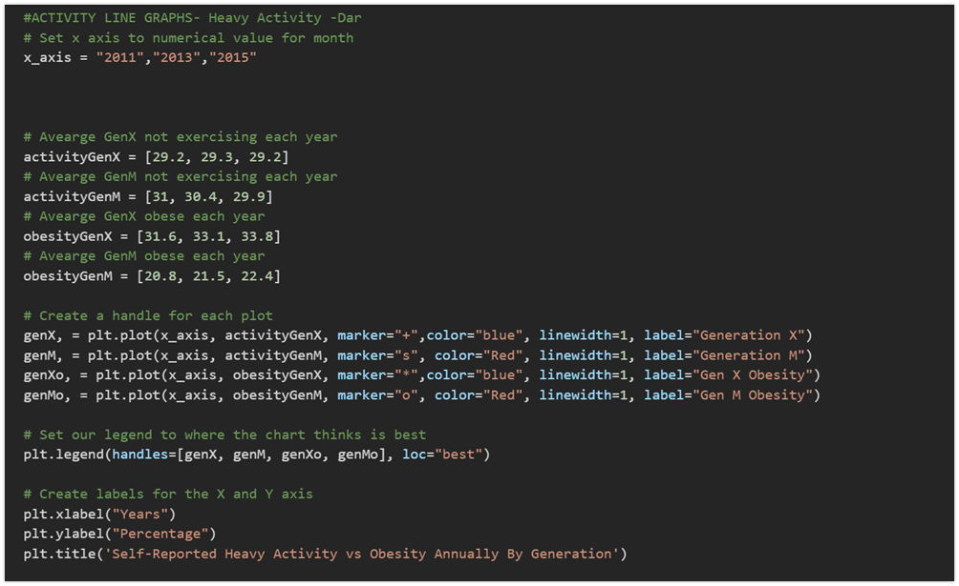
Does activity affect obesity over time, and how does it relate to different generations?

Slide 12
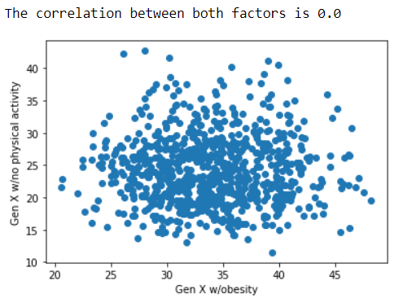
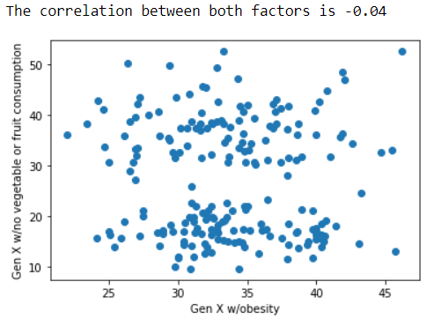
Generation X
Pearson correlation coefficient between ‘Being Obese’ and ‘No physical activity’
Pearson correlation coefficient between ‘Being Obese’ and ‘No vegetable or fruit consumption’

Slide 13
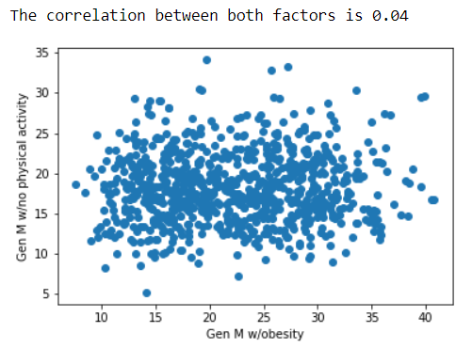
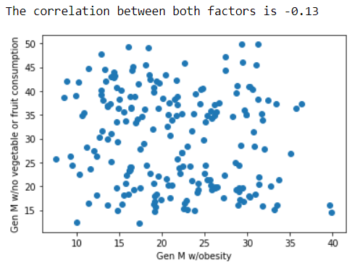
Millennials
Pearson correlation coefficient between ‘Being Obese’ and ‘No physical activity’
Pearson correlation coefficient between ‘Being Obese’ and ‘No vegetable or fruit consumption’

Slide 14
Correlation does not imply Causation
Statisticians everywhere

Slide 15
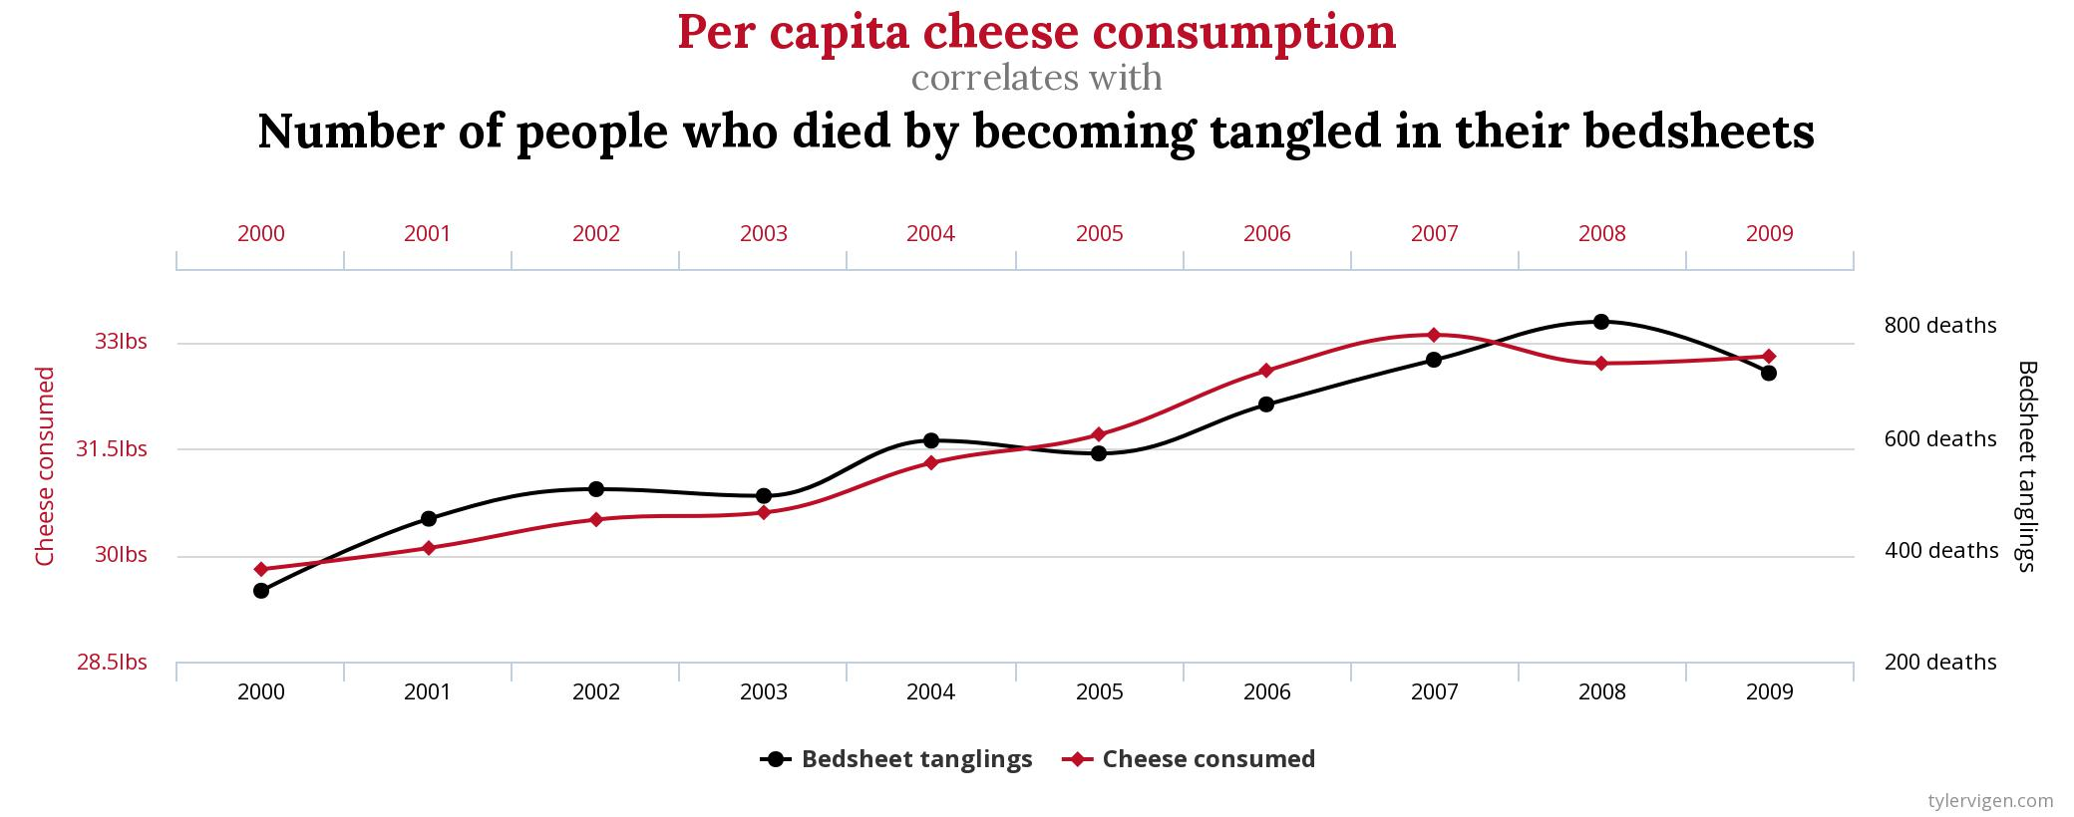

Slide 16
Discussion
No single nutrition behavior had significant correlation (negative or positive!) on Obesity Rates, but when like traits were combined it did (i.e. eating 0 veggies or fruit each week).
Exercise Behaviors had a significant impact on obesity rates for both generations.
Age and Generation seems to play a significant role in reported rates of obesity. Millennials show a correlation between their unhealthy eating habitats and obesity rates.

Slide 17

Post Mortem
ValueError: x and y must have the same length
Deleting a ‘(‘
NameError: name 'pd' is not defined
Notes:
To do a correlation between nutrition which includes the questions relative to eating veggies and fruits, we found that there was an uneven population between Gen X and Gen M and had to shrink the data.
The deleting the paren issue came from splitting the latitude and longitude data.
Re-Run your python script from the first cell constantly

Slide 18
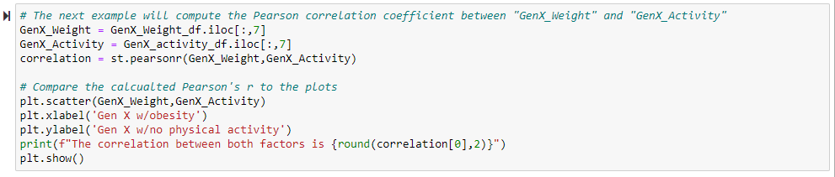
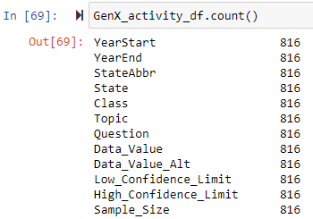
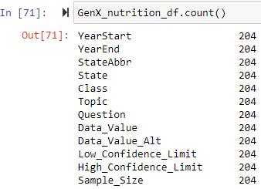
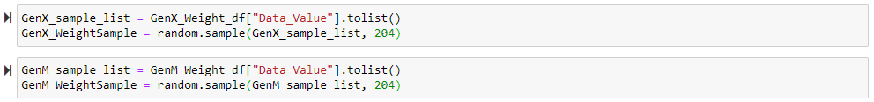
ValueError: x and y must have the same length.

Slide 19
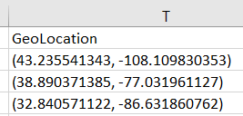
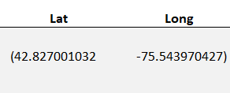
Deleting a ‘(‘
nutrition_data[['Lat','Long']] = nutrition_data.GeoLocation.str.split(",",expand=True,)

Slide 20
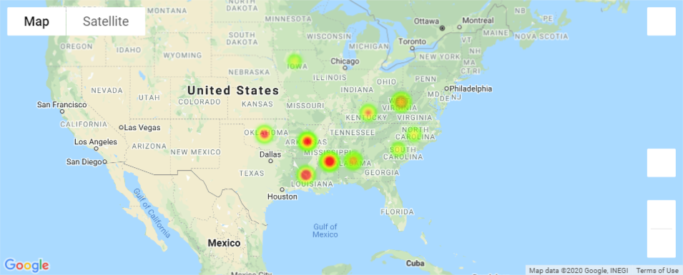
Heatmap of the Top 10 Areas for Obesity (GenX and Millennials combined)

Slide 21
Questions?
Open-floor Q&A with the audience

